Slide 1

ACCELERATING LEARNING AND RESEARCH
[insert name of university/institution] now offers a Campus-Wide License that provides unlimited use of MATLAB and Simulink to all students, faculty, staff, and researchers, on and off campus, on any device.
Gain access to:
The same tools used by engineers and scientists
Resources to increase MATLAB proficiency and complete assignments
[insert university/institution logo]
[insert portal link]

Slide 2





Why MATLAB and Simulink?
Millions of engineers and scientists worldwide use MATLAB and Simulink.
100,000+ business, government, and university sites
The top 10
auto manufacturers¹
All of the top 10
aerospace companies²
Three of the top five
internet companies
¹OICA: 2016 World Motor Vehicle Production
²PwC: Aerospace and Defense 2017 Year in Review
Notes:
Millions of engineers and scientists worldwide use MATLAB and Simulink
Our software is used at over 90,000 business, government, and university sites around the world
We have customers in established industries, like automotive and aerospace
The top 10 companies in each of these industries use MATLAB & Simulink
We also have customers in industries like internet services
For example, three of the top five internet companies—Amazon, Google, and Facebook—use MATLAB & Simulink for a wide range of applications
Automotive Top 10 source: 2016 International Organization of Motor Vehicle Manufacturers (OICA) world ranking of manufacturers by production
Aerospace Top 10 source: PwC Aerospace and Defense 2017 Year in Review and 2018 Forecast
Internet Top 5 source: Wikipedia list of largest Internet companies:
https://en.wikipedia.org/wiki/List_of_largest_Internet_companies

Slide 3




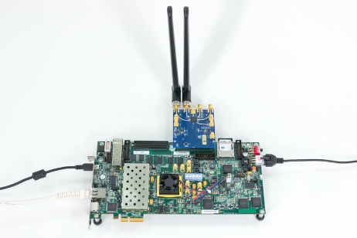




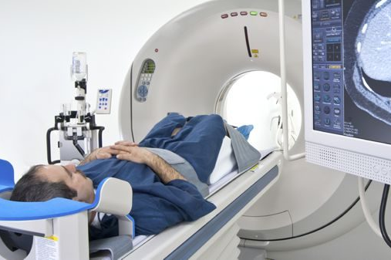




What industries use MATLAB and Simulink?
Aerospace and Defense | Automotive | Biological Sciences | Biotech and Pharmaceutical | Communications
Electronics | Energy Production | Financial Services | Industrial Machinery | Medical Devices
Metals, Materials, and Mining | Neuroscience | Railway Systems | Semiconductors | Software and Internet
Notes:
All told, our software is used in over 20 industries, from aerospace and automotive, to biotech, energy production, financial services, medical devices, and railway systems.
Now let’s see a few of the ways our customers and our products are changing the world

Slide 4
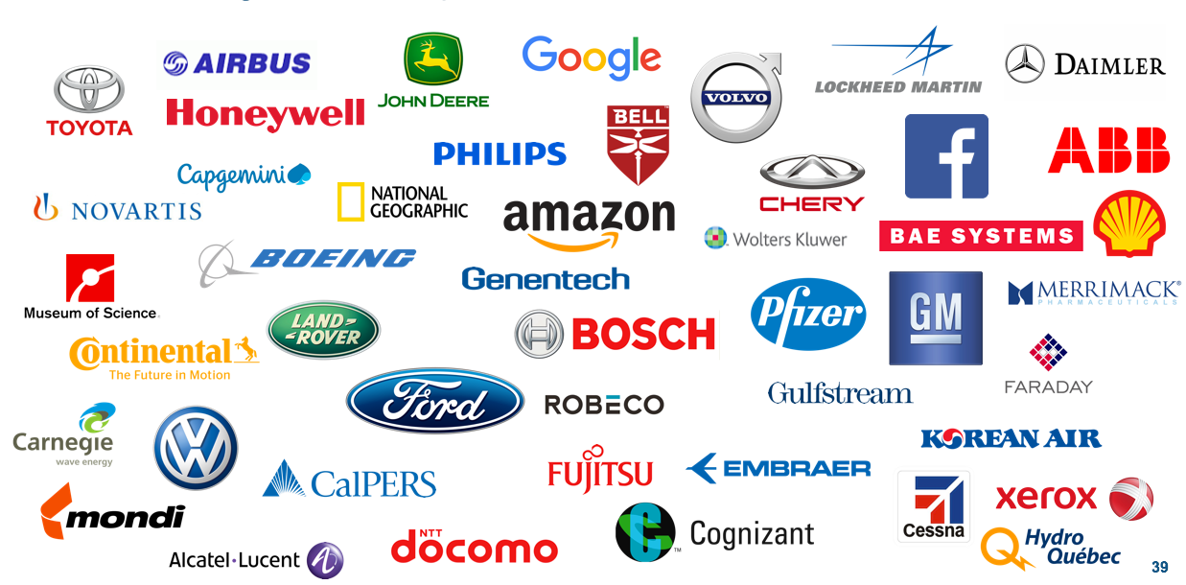
Where can graduates expect to use MATLAB and Simulink?
Notes:
Here are just a representative few of the 90,000+ businesses that use MATLAB & Simulink, and who seek job candidates that already possess these skills.

Slide 5
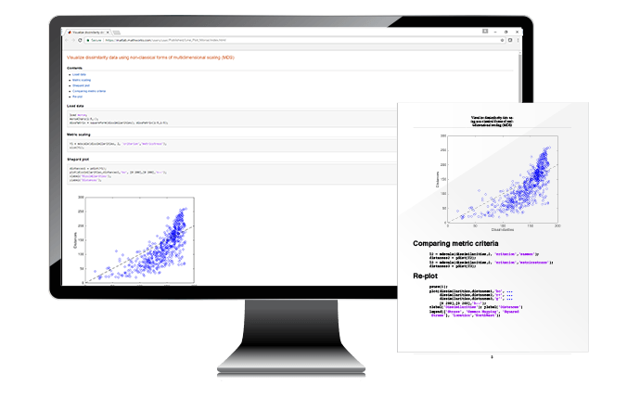
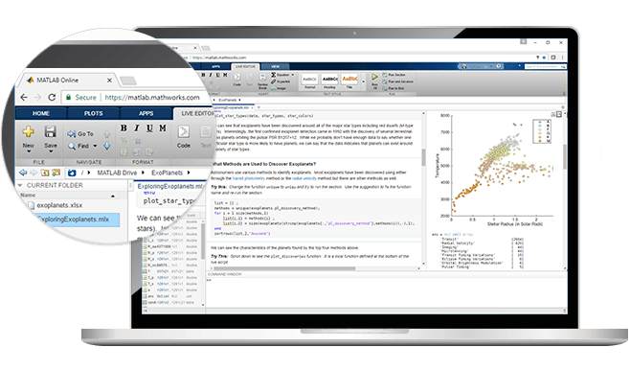
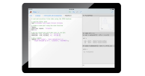
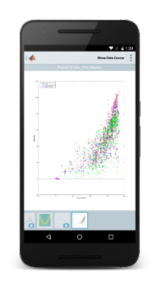



Anytime, Anywhere Access for Faculty, Staff, Students, and Visitors
MATLAB and Simulink
for Desktops
Access MATLAB and Simulink on personal and university-owned machines
MATLAB Online and Simulink Online
Access MATLAB and Simulink with a
web browser
MATLAB Mobile
Access MATLAB on
iOS/Android devices
Visit your university MATLAB portal
Visit matlab.mathworks.com
  Covers all on-campus facilities and home use (BYOD)
    MATLAB Desktop: Self-serve, users obtain personal standalone license
    MATLAB Online:
    MATLAB Mobile: Access MATLAB on iOS/Android devices
MATLAB FOR
Instructors
Students
Researchers
MATLAB FOR
Instructors
Students
Researchers
Notes:
MATLAB can be access via personal and university-owned machines, via a web browser with a MathWorks account, and on mobile devices.

Slide 6
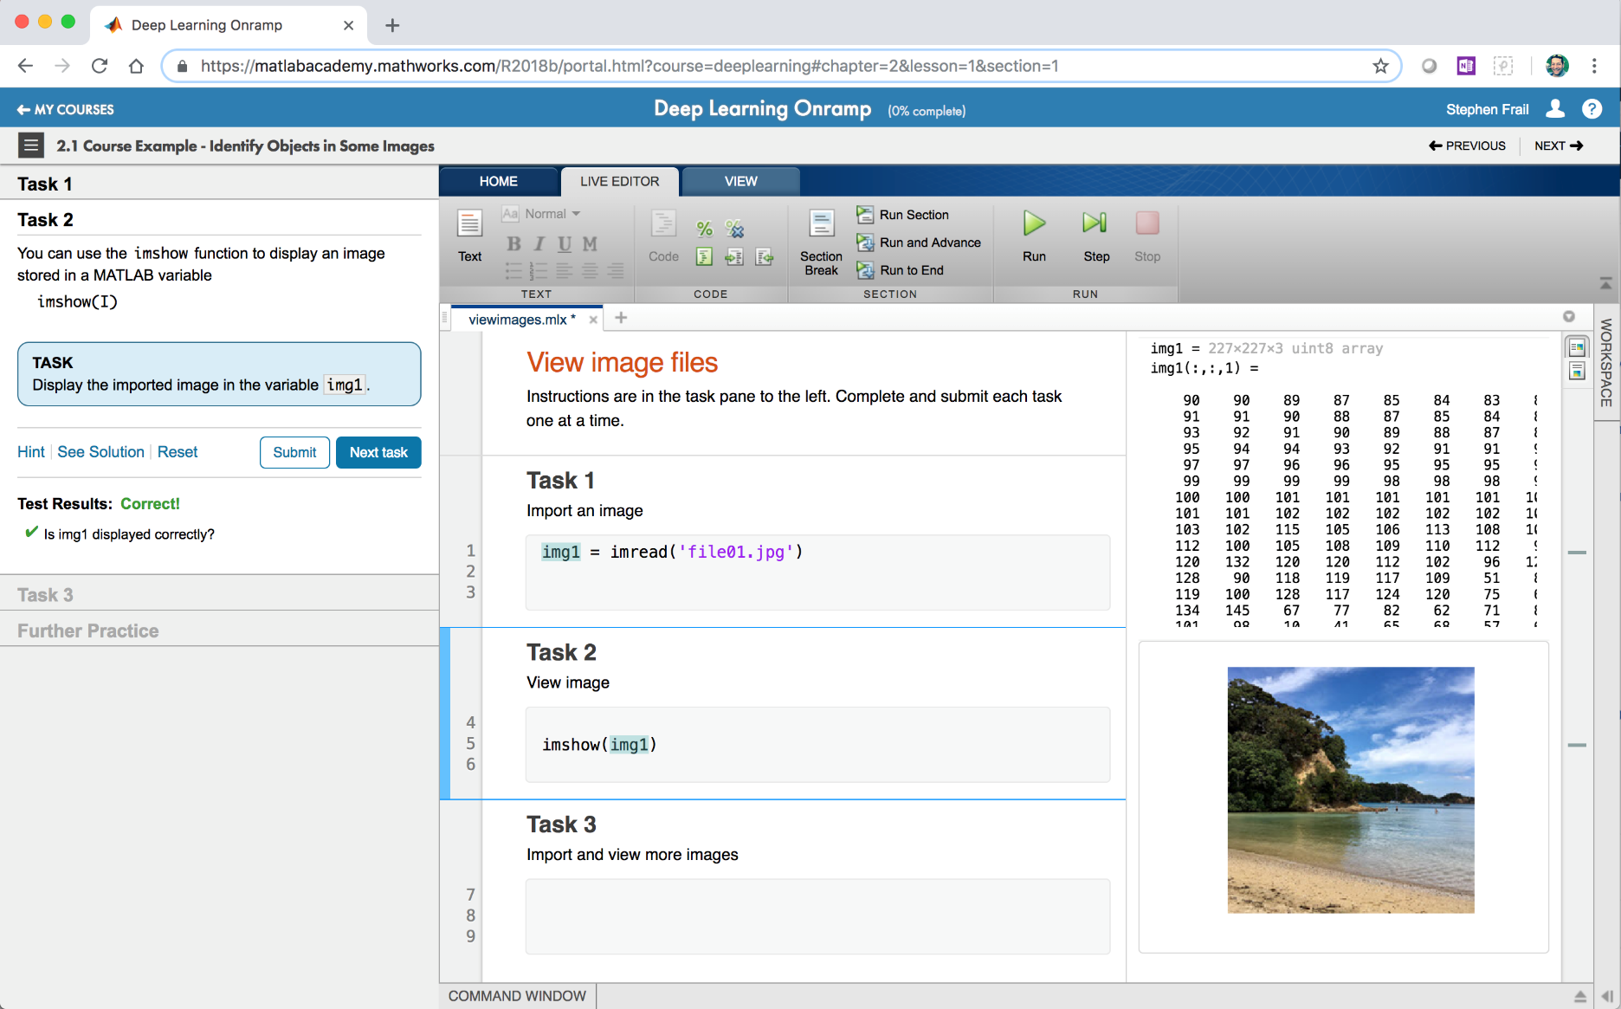
Self-Paced, Online Training for MATLAB and Simulink
  Online Training Suite
  Hands-on MATLAB and Simulink experience
  Measurable progress report and completion certificate
  Interactive lessons with immediate feedback
  24/7 availability
To learn more, visit mathworks.com/AcademicTraining
Notes:
Available only to Campus-Wide License holders, we offer a suite of self-paced online training courses for an additional fee. Campuses that opt for this add on open up unlimited hands on training on MATLAB & Simulink to all students, faculty and staff. Self-paced training helps helps students and faculty build up their skills while preserving valuable face-to-face class time. Progress reports and completion certificates can be uses for accountability.

Slide 7





















Available Self-Paced Training Courses
Getting Started
22 hours of FREE content—available for everyone
MATLAB
Onramp
Simulink
Onramp
Core MATLAB
Data Science
56 hours of comprehensive MATLAB learning content
Reinforcement Learning Onramp
Control Design Onramp with Simulink
MATLAB
Fundamentals
MATLAB for Data Processing and Visualization
MATLAB Programming Techniques
Image Processing with MATLAB
Deep Learning with MATLAB
Machine Learning with MATLAB
Signal Processing Onramp
Stateflow Onramp
Computational Mathematics
* Available exclusively to subscribers of the Online Training Suite
Deep Learning Onramp
Image Processing Onramp
11 hours of short courses on computational mathematics topics
Solving Nonlinear Equations with MATLAB
Solving Ordinary Differential Equations with MATLAB
Introduction to Linear Algebra with MATLAB
Introduction to Statistical Methods with MATLAB
Introduction to Symbolic Math with MATLAB
Machine Learning Onramp
Simscape Onramp
Find out more at [insert school’s portal link]

Slide 8

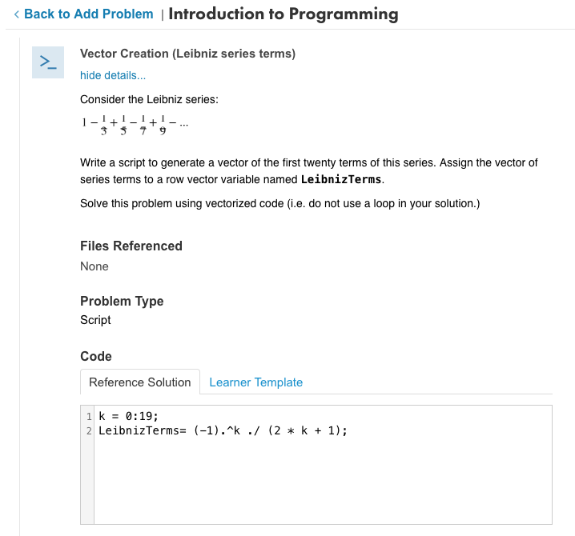
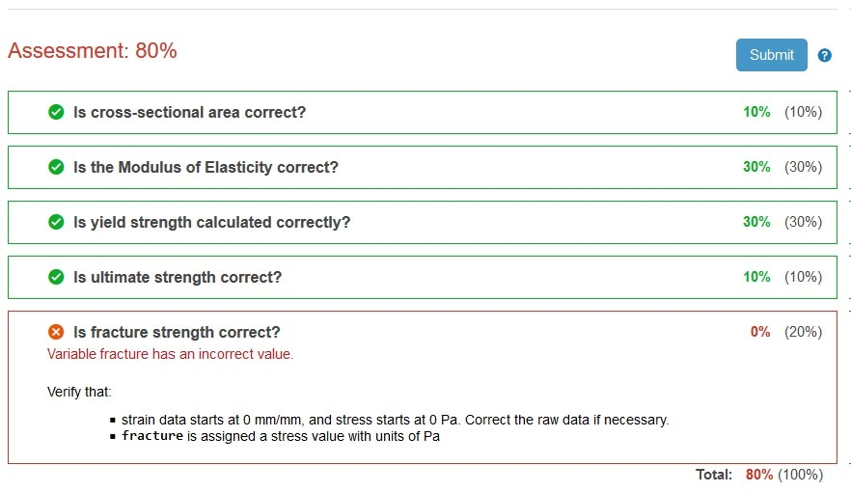



MATLAB Grader
Create interactive course assignments
Automatically grade student work and provide feedback
Run your assignments in any learning environment
Visit grader.mathworks.com
Notes:
For instructors wanting to make teaching MATLAB a core component of their course, or wanting auto-graded course assignments, we have designed MATLAB Grader. The paid version, only available with a Campus-Wide License, gives an unlimited number of students and faculties access to MATLAB Grader for all courses, for an annual flat fee. MATLAB Grader is LTI certified, allowing the paid version to be embedded in any LTI-capable learning management system.

Slide 9
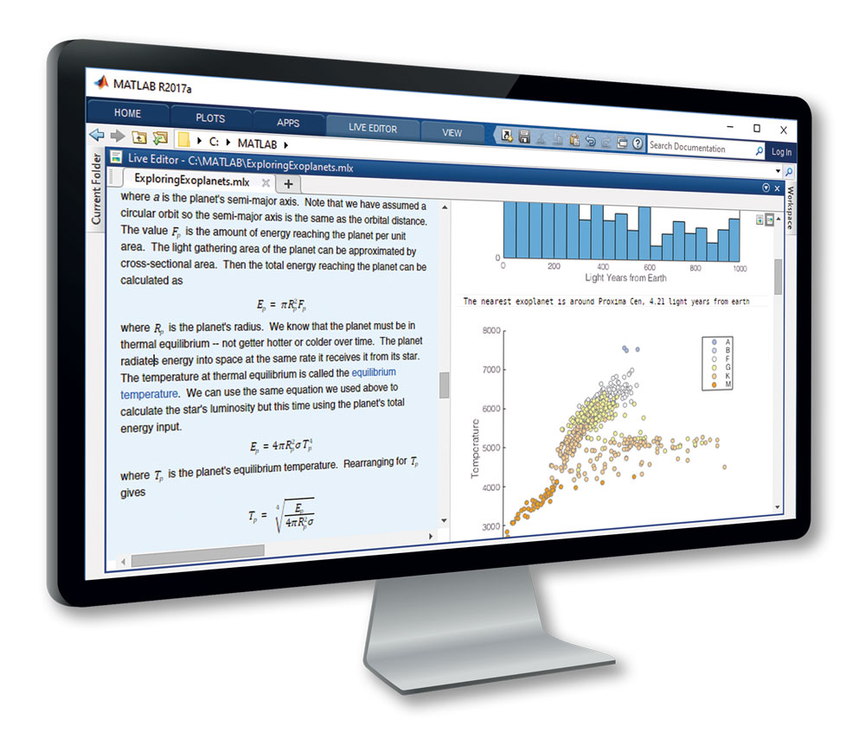
Teach with MATLAB Live Editor
  MATLAB in an Executable Notebook
  Use live scripts to create engaging lectures that combine explanatory text, mathematical equations, code, and results
  Share live scripts directly with colleagues or students
  Work in a single environment to eliminate context switching
Visit mathworks.com/products/matlab/live-editor
Notes:
For instructors looking to teach MATLAB through a notebook format, we offer MATLAB Live Editor complimentary with a Campus-Wide License. MATLAB code runs directly in LiveEditor, allowing faculty and students to work in a single environment to eliminate context switching.

